Slide 1
Image Restoration and Reconstruction
(Noise Removal)
Digital Image Processing
Christophoros Nikou
cnikou@cs.uoi.gr

Slide 2
Image Restoration and Reconstruction
Things which we see are not by themselves what we see…
It remains completely unknown to us what the objects may be by themselves and apart from the receptivity of our senses. We know nothing but our manner of perceiving them.
Immanuel Kant

Slide 3
Contents
In this lecture we will look at image restoration techniques used for noise removal
  What is image restoration?
  Noise and images
  Noise models
  Noise removal using spatial domain filtering
  Noise removal using frequency domain filtering

Slide 4
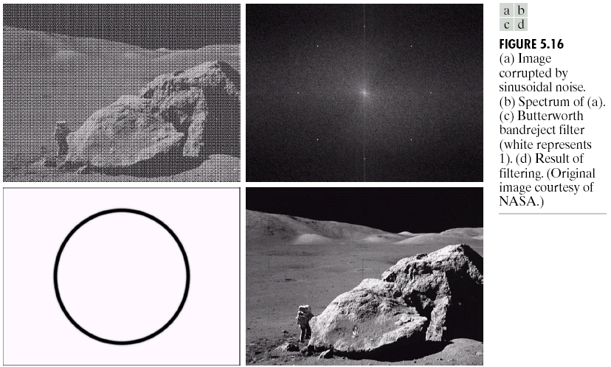
What is Image Restoration?
Image restoration attempts to restore images that have been degraded
  Identify the degradation process and attempt to reverse it
  Similar to image enhancement, but more objective

Slide 5
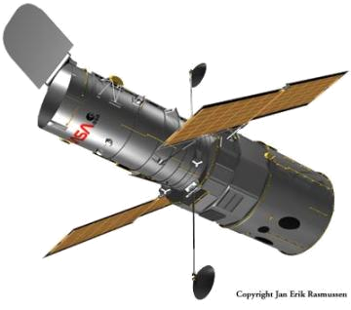
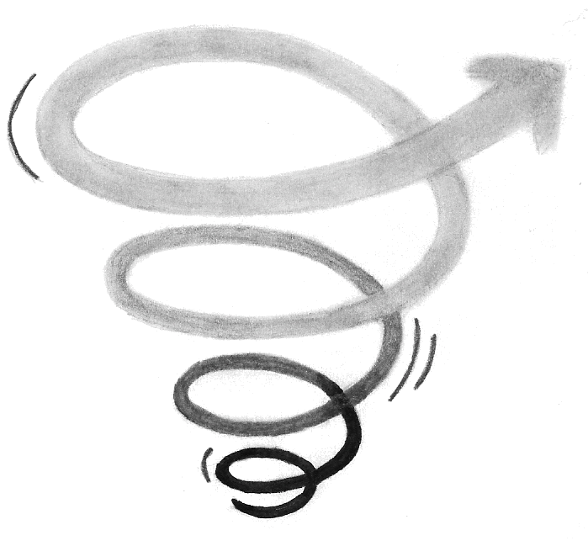

Noise and Images
The sources of noise in digital images arise during image acquisition (digitization) and transmission
  Imaging sensors can be affected by ambient conditions
  Interference can be added
  to an image during transmission

Slide 6
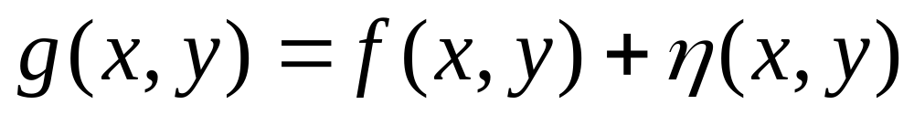
Noise Model
We can consider a noisy image to be modelled as follows:
where f(x, y) is the original image pixel, η(x, y) is the noise term and g(x, y) is the resulting noisy pixel
If we can estimate the noise model we can figure out how to restore the image

Slide 7
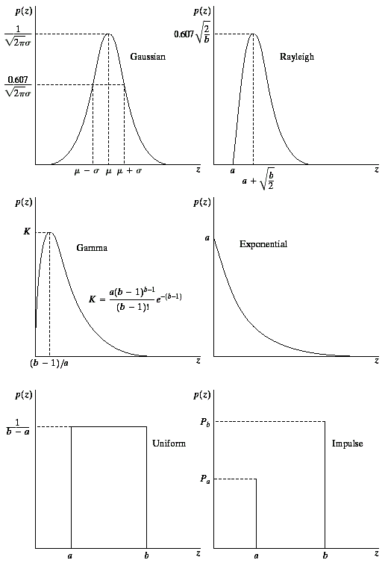

Noise Models (cont...)
There are many different models for the image
noise term η(x, y):
  Gaussian
    Most common model
  Rayleigh
  Erlang (Gamma)
  Exponential
  Uniform
  Impulse
    Salt and pepper noise
Gaussian
Rayleigh
Erlang
Exponential
Images taken from Gonzalez & Woods, Digital Image Processing (2002)
Uniform
Impulse

Slide 8
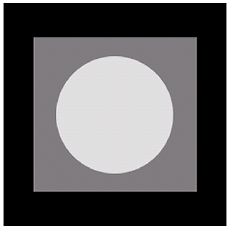
Noise Example
The test pattern to the right is ideal for demonstrating the addition of noise
The following slides will show the result of adding noise based on various models to this image
Image
Images taken from Gonzalez & Woods, Digital Image Processing (2002)
Histogram to go here
Histogram

Slide 9
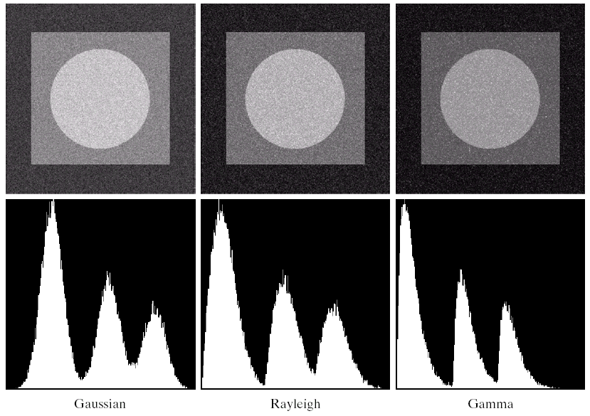
Noise Example (cont…)
Images taken from Gonzalez & Woods, Digital Image Processing (2002)
Gaussian
Rayleigh
Erlang

Slide 10
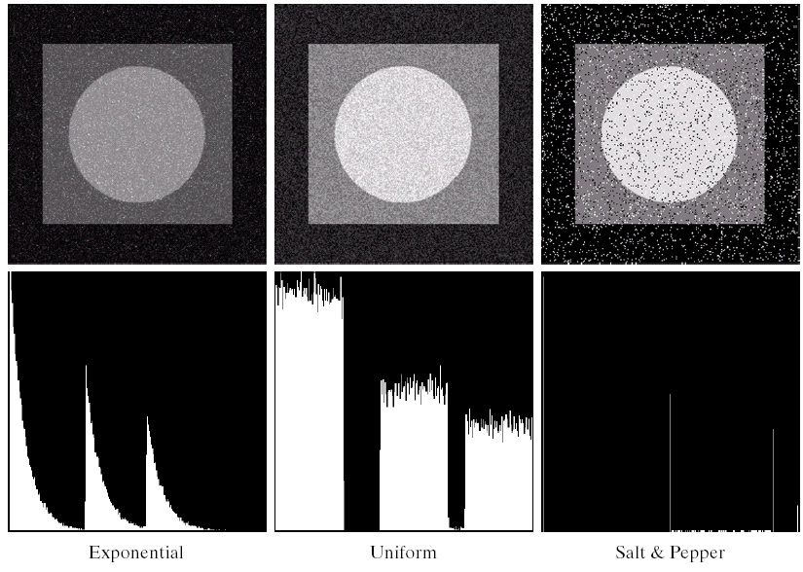
Noise Example (cont…)
Images taken from Gonzalez & Woods, Digital Image Processing (2002)
Histogram to go here
Exponential
Uniform
Impulse

Slide 11
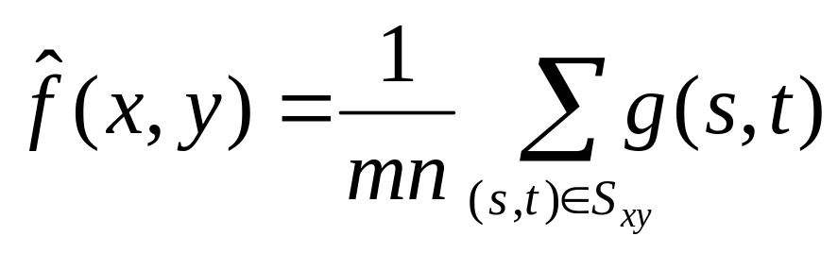
Filtering to Remove Noise
We can use spatial filters of different kinds to remove different kinds of noise
The arithmetic mean filter is a very simple one and is calculated as follows:
This is implemented as the
simple smoothing filter
It blurs the image.
¹/₉ | ¹/₉ | ¹/₉
¹/₉ | ¹/₉ | ¹/₉
¹/₉ | ¹/₉ | ¹/₉

Slide 12
Other Means
There are different kinds of mean filters all of which exhibit slightly different behaviour:
  Geometric Mean
  Harmonic Mean
  Contraharmonic Mean

Slide 13

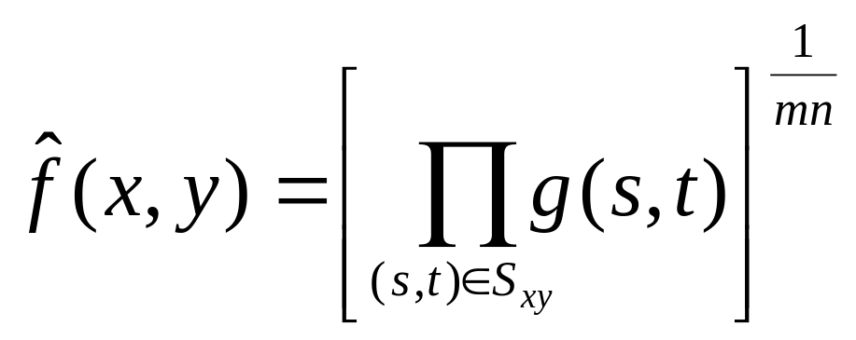
Other Means (cont…)
Geometric Mean:
Achieves similar smoothing to the arithmetic mean, but tends to lose less image detail.

Slide 14
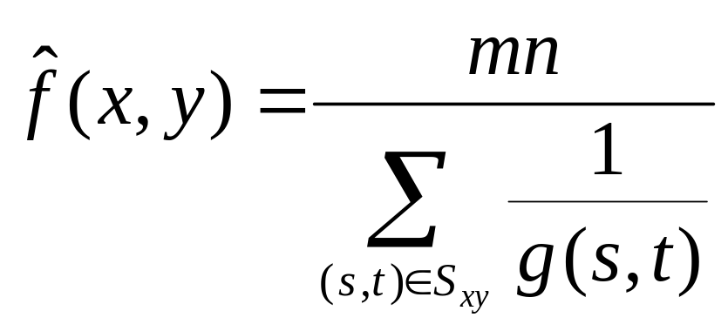
Other Means (cont…)
Harmonic Mean:
Works well for salt noise, but fails for pepper noise.
Also does well for other kinds of noise such as Gaussian noise.

Slide 15
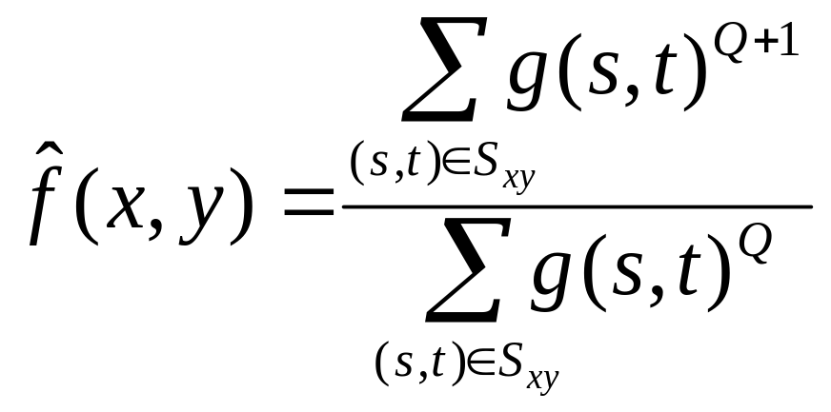
Other Means (cont…)
Contraharmonic Mean:
Q is the order of the filter.
Positive values of Q eliminate pepper noise.
Negative values of Q eliminate salt noise.
It cannot eliminate both simultaneously.

Slide 16
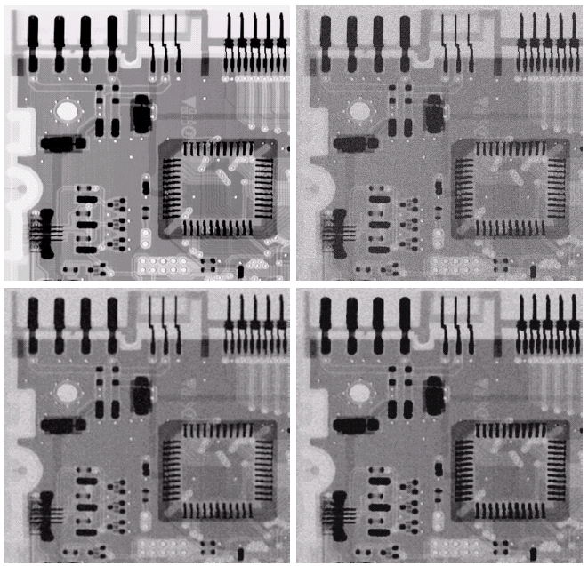
Noise Removal Examples
Image
corrupted
by Gaussian
noise
Original image
Images taken from Gonzalez & Woods, Digital Image Processing (2002)
3x3
Geometric
Mean Filter (less blurring than AMF, the image is sharper)
3x3 Arithmetic
Mean Filter

Slide 17
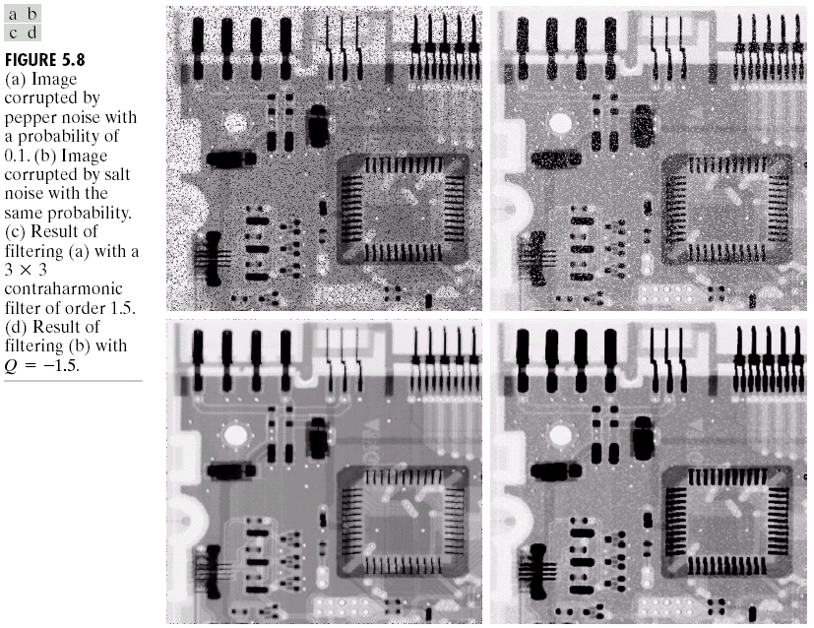
Noise Removal Examples (cont…)
Image corrupted by pepper noise at 0.1
Images taken from Gonzalez & Woods, Digital Image Processing (2002)
Filtering with a 3x3 Contraharmonic Filter with Q=1.5

Slide 18
Noise Removal Examples (cont…)
Image corrupted by salt noise at 0.1
Images taken from Gonzalez & Woods, Digital Image Processing (2002)
Filtering with a 3x3 Contraharmonic Filter with Q=-1.5

Slide 19
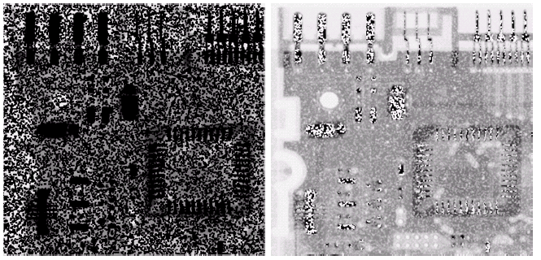
Contraharmonic Filter: Here Be Dragons
Choosing the wrong value for Q when using the contraharmonic filter can have drastic results
Images taken from Gonzalez & Woods, Digital Image Processing (2002)
Pepper noise filtered by a 3x3 CF with Q=-1.5
Salt noise filtered by a 3x3 CF with Q=1.5

Slide 20
Order Statistics Filters
Spatial filters based on ordering the pixel values that make up the neighbourhood defined by the filter support.
Useful spatial filters include
  Median filter
  Max and min filter
  Midpoint filter
  Alpha trimmed mean filter
Images taken from Gonzalez & Woods, Digital Image Processing (2002)

Slide 21
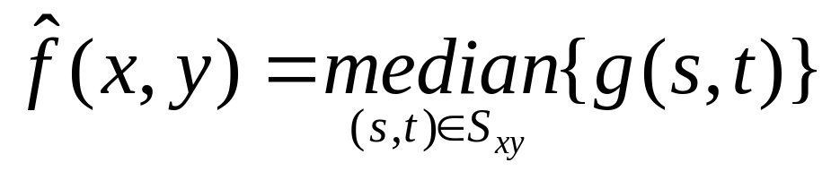
Median Filter
Median Filter:
Excellent at noise removal, without the smoothing effects that can occur with other smoothing filters.
Particularly good when salt and pepper noise is present.

Slide 22
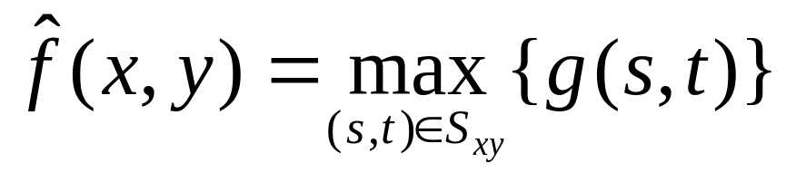
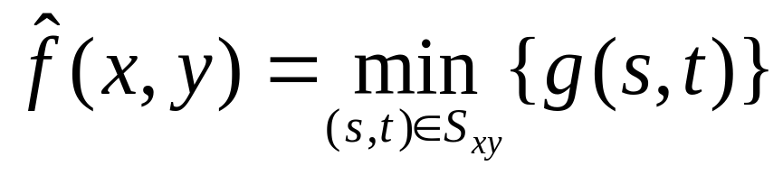
Max and Min Filter
Max Filter:
Min Filter:
Max filter is good for pepper noise and Min filter is good for salt noise.

Slide 23
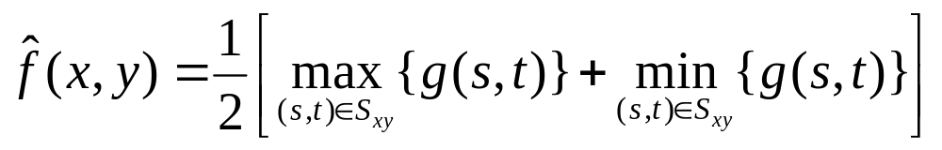
Midpoint Filter
Midpoint Filter:
Good for random Gaussian and uniform noise.

Slide 24
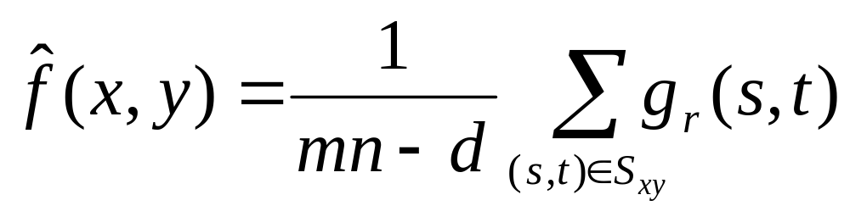
Alpha-Trimmed Mean Filter
Alpha-Trimmed Mean Filter:
We can delete the d/2 lowest and d/2 highest grey levels.
So g_{r}(s, t) represents the remaining mn – d pixels.

Slide 25
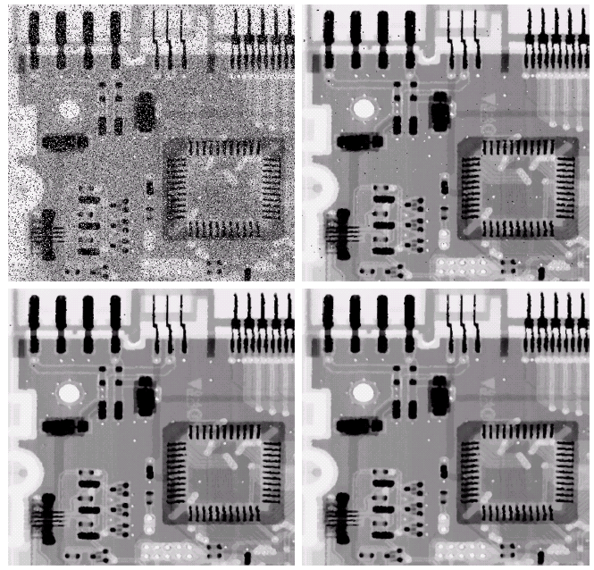
Noise Removal Examples
Image
corrupted
by Salt And
Pepper noise
at 0.2
Result of 1
pass with a
3x3 Median
Filter
Images taken from Gonzalez & Woods, Digital Image Processing (2002)
Result of 2
passes with
a 3x3 Median
Filter
Result of 3
passes with
a 3*3 Median
Filter
Repeated passes remove the noise better but also blur the image

Slide 26
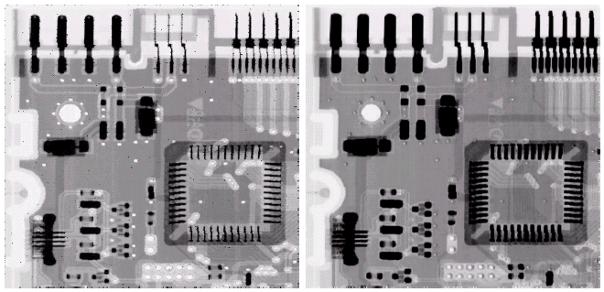
Noise Removal Examples (cont…)
Image
corrupted
by Pepper
noise
Image
corrupted
by Salt
noise
Images taken from Gonzalez & Woods, Digital Image Processing (2002)
Filtering
above
with a 3x3
Max Filter
Filtering
above
with a 3x3
Min Filter

Slide 27
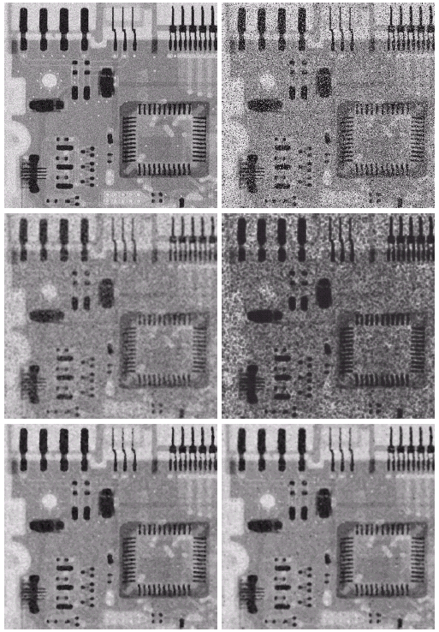
Noise Removal Examples (cont…)
Image
corrupted
by uniform
noise
Image further
corrupted
by Salt and
Pepper noise
Filtering by a
5x5 Arithmetic
Mean Filter
Filtering by a
5x5 Geometric
Mean Filter
Images taken from Gonzalez & Woods, Digital Image Processing (2002)
Filtering by a
5x5 Median
Filter
Filtering by a
5x5 Alpha-Trimmed
Mean Filter (d=5)

Slide 28
Adaptive Filters
The filters discussed so far are applied to an entire image without any regard for how image characteristics vary from one point to another.
The behaviour of adaptive filters changes depending on the characteristics of the image inside the filter region.
We will take a look at the adaptive median filter.

Slide 29
Adaptive Median Filtering
The median filter performs relatively well on impulse noise as long as the spatial density of the impulse noise is not large.
The adaptive median filter can handle much more spatially dense impulse noise, and also performs some smoothing for non-impulse noise.

Slide 30
Adaptive Median Filtering (cont…)
The key to understanding the algorithm is to remember that the adaptive median filter has three purposes:
  Remove impulse noise
  Provide smoothing of other noise
  Reduce distortion (excessive thinning or thickenning of object boundaries).

Slide 31
Adaptive Median Filtering (cont…)
In the adaptive median filter, the filter size changes depending on the characteristics of the image.
Notation:
  S_{xy} = the support of the filter centerd at (x, y)
  z_{min} = minimum grey level in S_{xy}
  z_{max} = maximum grey level in S_{xy}
  z_{med} = median of grey levels in S_{xy}
  z_{xy} = grey level at coordinates (x, y)
  S_{max} =maximum allowed size of S_{xy}

Slide 32
Adaptive Median Filtering (cont…)
Stage A: A1 = z_{med} – z_{min}
A2 = z_{med} – z_{max}
If A1 > 0 and A2 < 0, Go to stage B
Else increase the window size
If window size ≤ S_{max} repeat stage A
Else output z_{med}
Stage B: B1 = z_{xy} – z_{min}
B2 = z_{xy} – z_{max}
If B1 > 0 and B2 < 0, output z_{xy}
Else output z_{med}

Slide 33
Adaptive Median Filtering (cont…)
Stage A: A1 = z_{med} – z_{min}
A2 = z_{med} – z_{max}
If A1 > 0 and A2 < 0, Go to stage B
Else increase the window size
If window size ≤ S_{max} repeat stage A
Else output z_{med}
Stage A determines if the output of the median filter z_{med} is an impulse or not (black or white).
If it is not an impulse, we go to stage B.
If it is an impulse the window size is increased until it reaches S_{max} or z_{med} is not an impulse.
Note that there is no guarantee that z_{med} will not be an impulse. The smaller the the density of the noise is, and, the larger the support S_{max}, we expect not to have an impulse.

Slide 34
Adaptive Median Filtering (cont…)
Stage B: B1 = z_{xy} – z_{min}
B2 = z_{xy} – z_{max}
If B1 > 0 and B2 < 0, output z_{xy}
Else output z_{med}
Stage B determines if the pixel value at (x, y), that is z_{xy}, is an impulse or not (black or white).
If it is not an impulse, the algorithm outputs the unchanged pixel value z_{xy} .
If it is an impulse the algorithm outputs the median z_{med} .

Slide 35
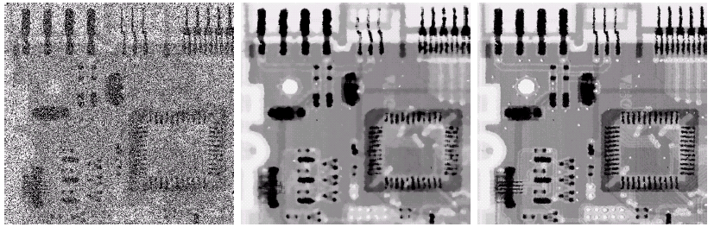
Adaptive Filtering Example
Images taken from Gonzalez & Woods, Digital Image Processing (2002)
Image corrupted by salt and pepper noise with probabilities P_{a} = P_{b}=0.25
Result of filtering with a 7x7 median filter
Result of adaptive median filtering with
S_{max} = 7
AMF preserves sharpness and details, e.g. the connector fingers.

Slide 36
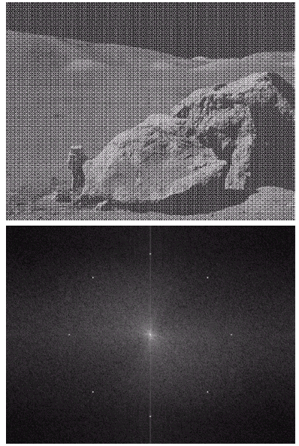
Periodic Noise
Typically arises due to
electrical or electromagnetic
interference.
Gives rise to regular noise
patterns in an image.
Frequency domain techniques in the Fourier domain are most effective at removing periodic noise.
Images taken from Gonzalez & Woods, Digital Image Processing (2002)

Slide 37
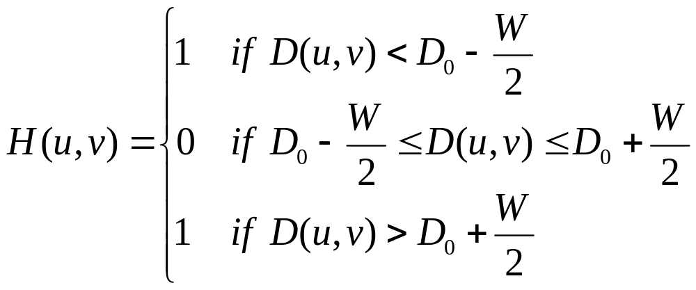
Band Reject Filters
Removing periodic noise form an image involves removing a particular range of frequencies from that image.
Band reject filters can be used for this purpose
An ideal band reject filter is given as follows:

Slide 38
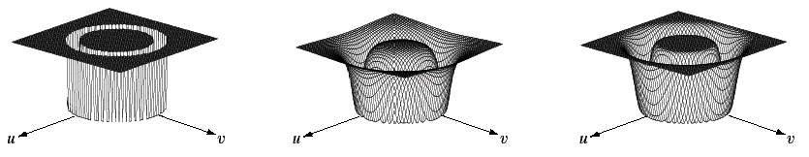
Band Reject Filters (cont…)
The ideal band reject filter is shown below, along with Butterworth and Gaussian versions of the filter
Images taken from Gonzalez & Woods, Digital Image Processing (2002)
Ideal Band
Reject Filter
Butterworth
Band Reject
Filter (of order 1)
Gaussian
Band Reject
Filter

Slide 39
Band Reject Filter Example
Image corrupted by sinusoidal noise
Fourier spectrum of corrupted image
Images taken from Gonzalez & Woods, Digital Image Processing (2002)
Butterworth band reject filter
Filtered image

